Slide 1
Classification Algorithms
COMP2420/6420

Slide 2
When do we use Classification?
Given an input data, assign it to 1 of K discrete classes
Divide the input space into different regions
Equivalently, map each point to a category/label

Slide 3
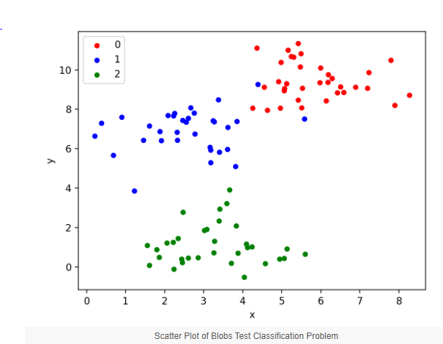

Slide 4
Types of Models for such Decision Problems
Find a Discriminant Function
Discriminative Models
Generative Models
We are going to find a discriminant function that directly maps each input to a class label.

Slide 5
Logistic Regression
Map W.T@X + b to a probability
The loss function is differentiable
Linear boundaries

Slide 6
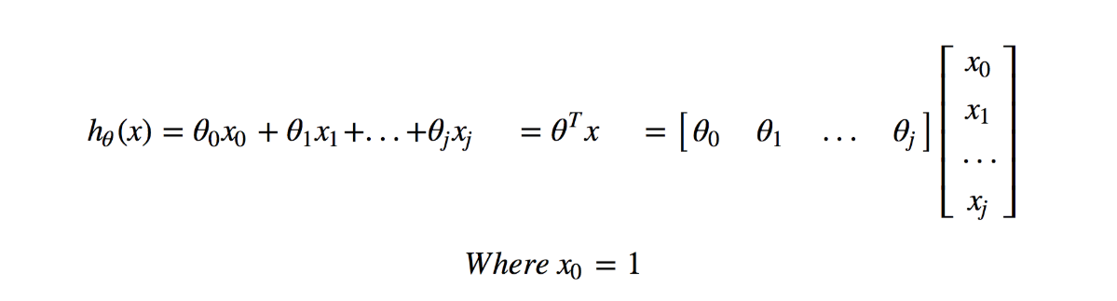
Hypothesis

Slide 7
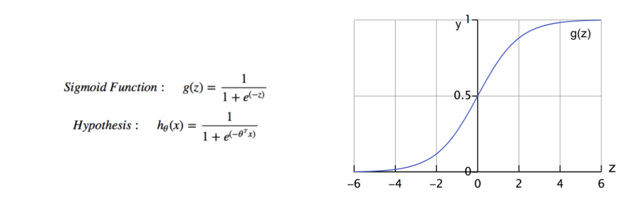

Slide 8
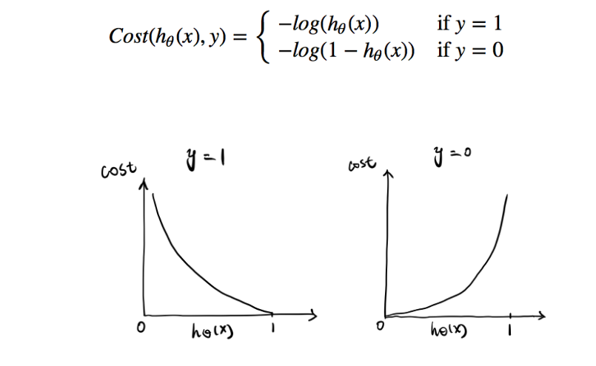

Slide 9
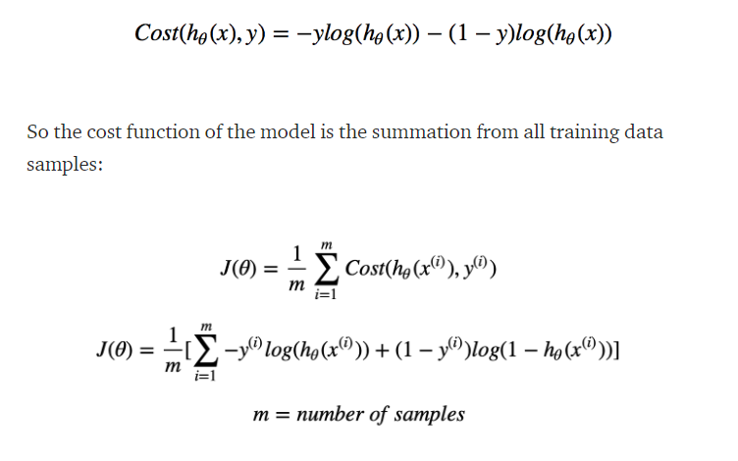
Logistic Loss for Binary Logistic Regression

Slide 10
Nearest Neighbours
Test time high – can be optimised by using optimised sorting techniques
Curse of dimensionality – concept of distance in higher-dims
Hyperparameters – k, which distance

Slide 11
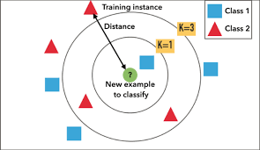

Slide 12
Coding Part

Slide 13
Steps
EDA – Explorative Data Analysis
Look at the data, stats like mean, median, mode of each feature
E.g. distribution of each plcass, fares, etc.
Any nulls, missing data? Scaling?
Choose columns you see as relevant and that is your data
Split into train and test
Fit the model on the training set and then test it on the test set

Slide 14
Some important functions
L = LabelEncoder()
L.fit(iris[“species”])
Iris[“species”] = L.transform(iris[“species”])
S = StandardScaler()
S.fit(train)
S.transform(train)
S.transform(test)

